Slide 1

Algorithms for complete Physiological Monitoring During Spaceflight
Michigan State University
Department of Computer Science and Engineering
Aven Zitzelberger – Undergraduate
Dr. Mohammad Ghassemi - Mentor

Slide 2
Motivation:
Continuous, real-time monitoring of astronaut physiology is hard.
Many sensors collectively prone to malfunction
Repair/replacements not available
Current approaches limit mobility and comfort
ECG electrodes
Blood pressure cuff (not continuous)
Intravenous BP sensor (invasive)
Possible Solutions:
Remotely transmit data
Find new methods of monitoring certain vitals
Analyze data in real time
Identify redundancy in sensors
Notes:
Continuously monitoring the physiology of astronauts is hard.
The more sensors you have, the more likely a malfunction is to happen, and replacements are not available. Many sensors and wires also limit mobility and comfort, and thus limit the ability for continual monitoring.
In particular, blood pressure measurements are difficult to take, while being an extremely important signal to monitor. Blood pressure cuffs cannot be used continuously and mobility is sacrificed during the reading, and intravenous sensors, while continuous, are extremely invasive and uncomfortable.
What can we do to solve this?
Ideally, all vitals should be able to be remotely monitored.
We must look for new and innovative ways to obtain certain readings, such as blood pressure
Identify and eliminate redundancy in monitoring systems – what do we mean by that?

Slide 3
Previous Research
Extrapolation of bio-signals from other measurements
PPG readings can be used to accurately reconstruct ECG data
Q. Zhu, X. Tian, C.-W. Wong, and M. Wu, “ECG Reconstruction via PPG: A Pilot Study,” in 2019 IEEE EMBS International Conference on Biomedical Health Informatics (BHI), May 2019, pp. 1–4, doi: 10.1109/BHI.2019.8834612
ECG and PTT data can be used to predict blood pressure readings
O. Viunytskyi, V. Shulgin, V. Sharonov, and A. Totsky, “Non-invasive Cuff-less Measurement of Blood Pressure Based on Machine Learning,” in 2020 IEEE 15th International Conference on Advanced Trends in Radioelectronics, Telecommunications and Computer Engineering TCSET), Feb. 2020, pp. 203–206, doi: 10.1109/TCSET49122.2020.235423
PPG and PTT data can thus be used to predict blood pressure readings (with up to 95% accuracy!). D. Jia and W. Yin, “Continuous blood pressure prediction based on hierarchical adaptive algorithm,” in 2020 IEEE 4th Information Technology, Networking, Electronic and Automation Control Conference (ITNEC), Jun. 2020, vol. 1, pp. 934–938, doi: 10.1109/ITNEC48623.2020.9084725.
Notes:
Lets look at some current research in the area.
Just last year, it was shown that Photoplethysmogram readings can be used to reconstruct data that would be taken from an Ecocardiogram.
Early this year, An Ecocardiogram along with Pulse Transit Time data was used to predict continuous blood pressure readings.
From this is may seem plausible to use a Photoplethysmogram and Pulse Transit Time to predict blood pressure, and indeed in June of this year it was shows to be possible with an astonishingly high degree of accuracy.
This is an extraordinary accomplishment because PPG and PPT reading are non-invasive, easily obtainable, and require only two sensors between them.

Slide 4
Overall Objectives
Develop algorithms for real-time reconstruction of physiological data
Discover minimal subset of monitors needed for a given set of vital signals
Roadmap:
Build baseline framework
Accessible Bio-signal streaming application
Real-time analysis network
Proof of concept
Achieve objectives with publicly available bio-signal datasets
Behavioral study
Test ability to predict human bio-signals in various environments
Test efficacy of transfer learning
Application
Apply algorithms to critical physiological waveforms in a weightless environment
Notes:
So what do we hope to add to this research?
Ultimately our goal is to develop deep learning algorithms that can reconstruct any given bio-signal in the presence of redundant data. And through this, we hope to be able to identify the minimal subset of sensors required to achieve that reconstruction.
To accomplish this, the first step is to build a framework with which to do this research. I am currently building software to stream live data from wearable devices to a remote data-analysis server, where it can be fed through machine learning algorithms and give feedback.
Following this, we will use publicly available datasets to train and test our software, where we expect to see robust correlations indicating redundancy in a wide variety of bio-signals.
Then we would be collection our own data and performing behavioral studies, testing out algorithm in real-world situations and testing its ability to transfer it’s acquired knowledge to novel situations
Finally, we would like the ability of our application to reconstruct bio-signals in the weightless environment of a spacecraft.

Slide 5
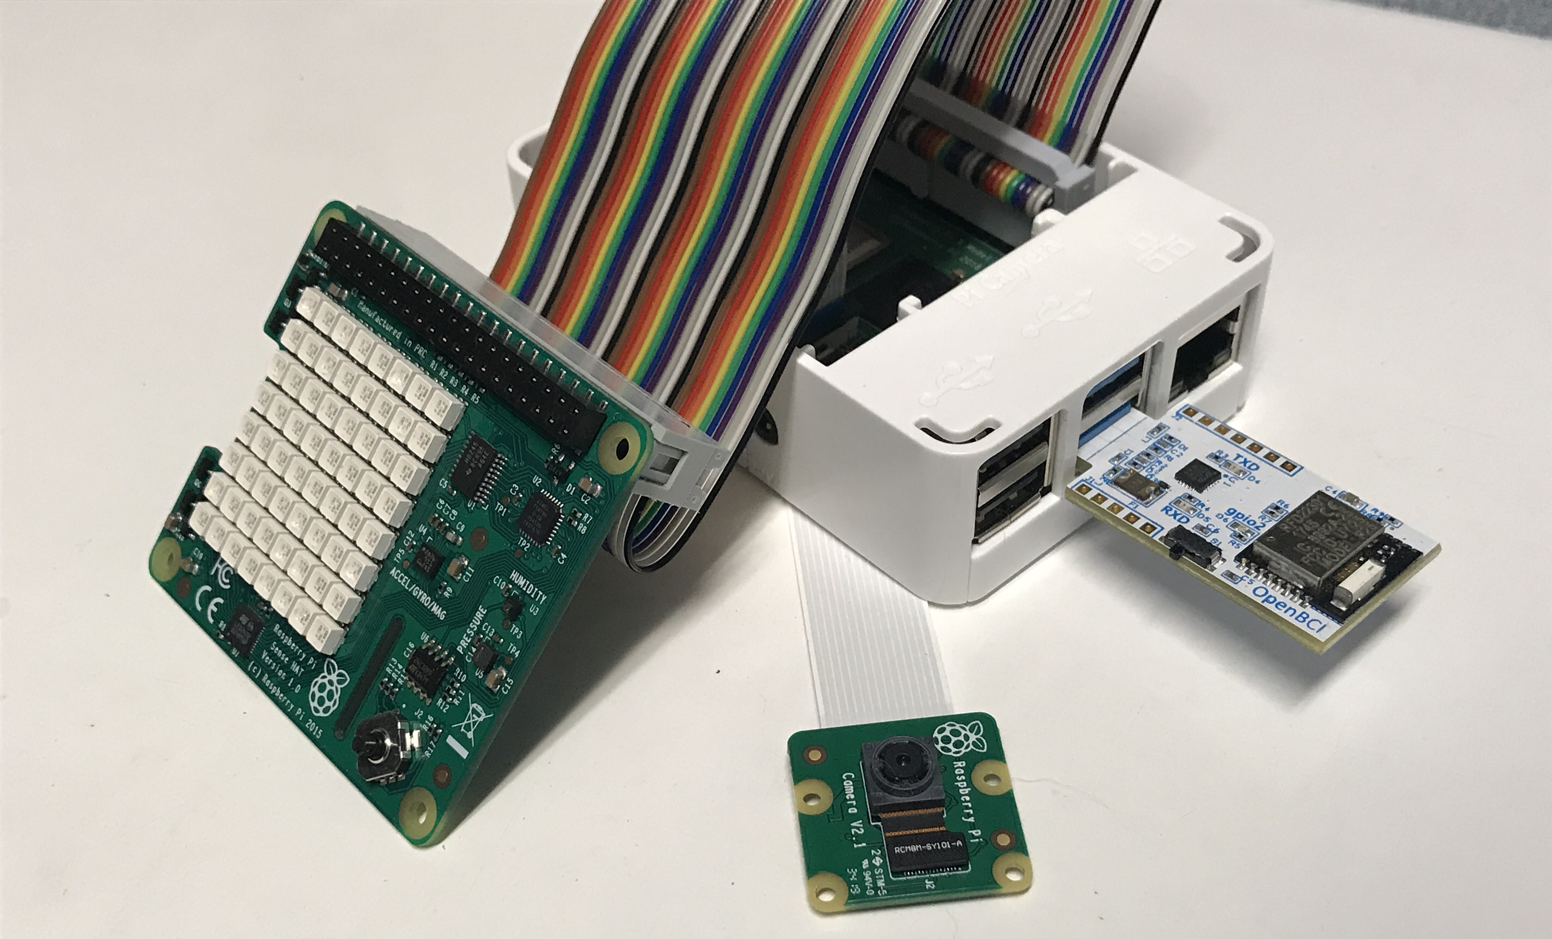
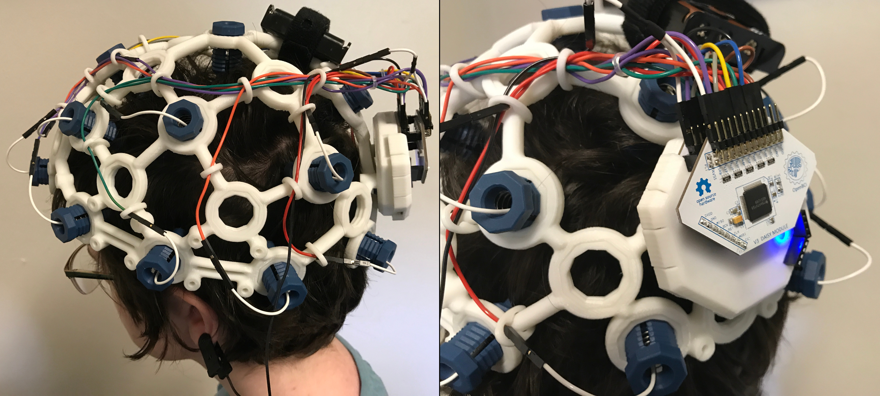
Progress
Current stage: building the framework
Pi Sense Hat streams temperature, humidity, pressure, and gyroscopic data
Picam streams a live video feed of subject
OpenBCI headset streams EEG data to its corresponding dongle on the Raspberry Pi.
All data streams are organized and packaged by the Pi, then streamed to our data-ingestion server for analysis.
Notes:
Here is an example of our progress so far. We are using a raspberry pi as the local device used to collect data. Environmental information (temperature, humidity, pressure, etc..) and a live video feed is collected directly from the Pi.
We have an EEG device transmitting live data to the dongle on the Pi.
All this data is packaged and sent to our remote server.

Slide 6
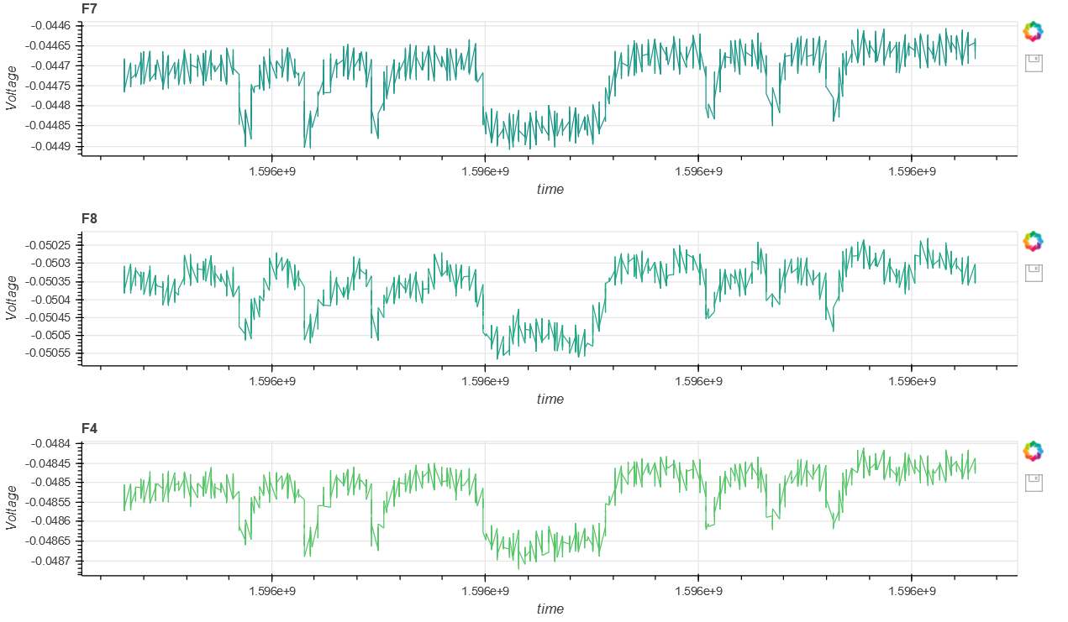
The data can then be directly viewed in a browser window after processing, along with a simple FFT analysis which will be used as input for the deep learning algorithm.
This shows a simple demonstration showing eye blinks registered on the F7, F8, and F4 electrode locations.
Notes:
Any browser can then be used to view the data after processing. This is where the classification and deep learning analysis will be viewed.

